Slide 1
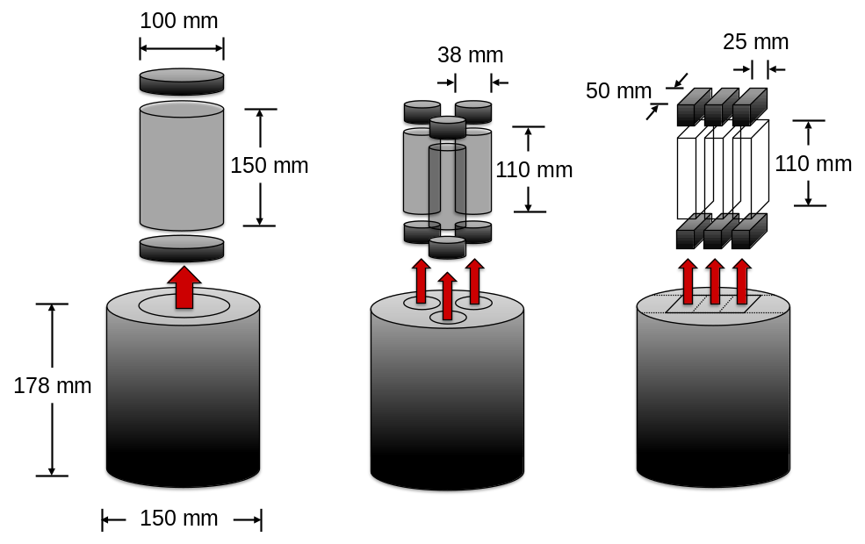



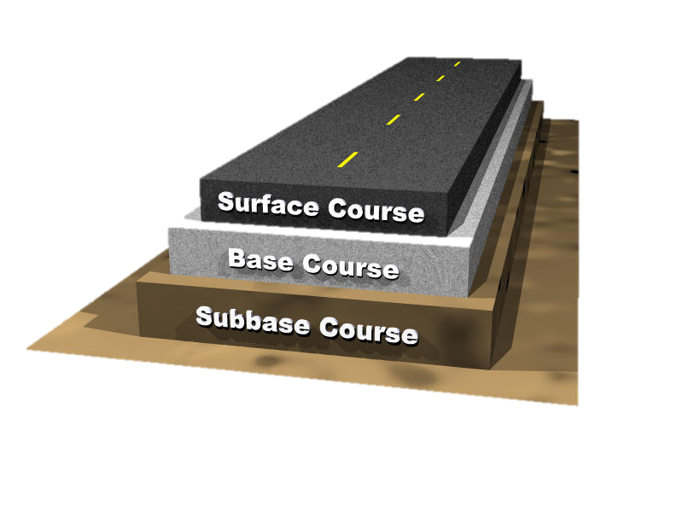
Evaluation of Small Specimen Geometries for Asphalt Mixture Performance Testing and Pavement Performance Prediction
Kangjin Lee
Graduate Research Assistant
Sonja Pape
Graduate Research Assistant
Cassie Castorena, Ph.D.
Assistant Professor
Y. Richard Kim, Ph.D., P.E., F.ASCE
Jimmy D. Clark Distinguished University Professor

Slide 2
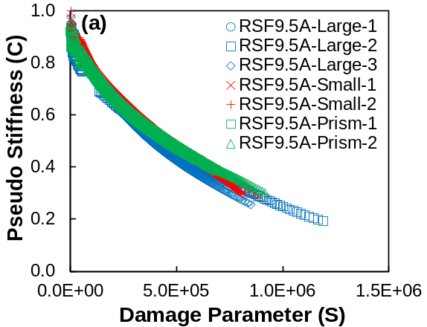
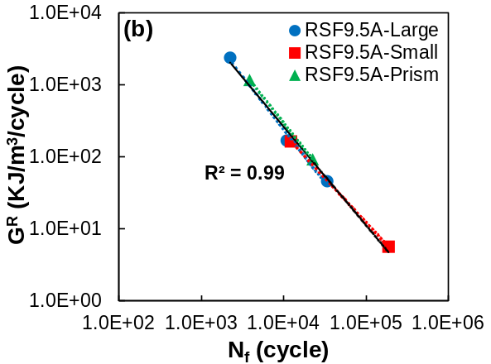
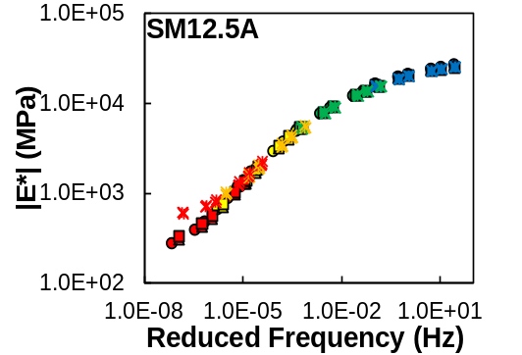
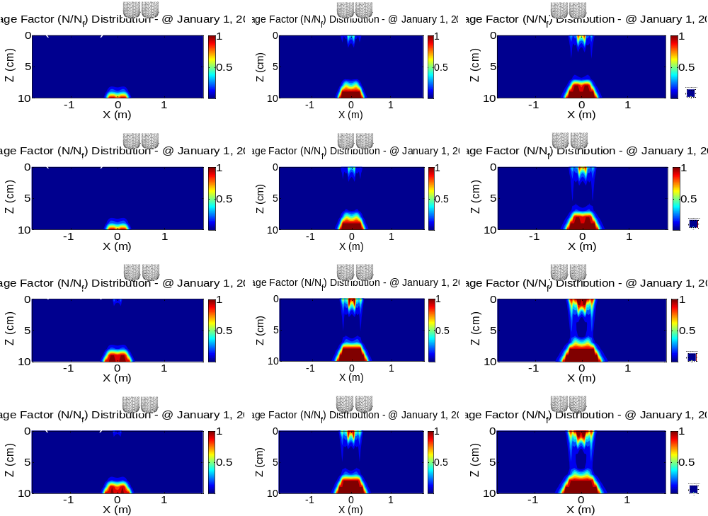
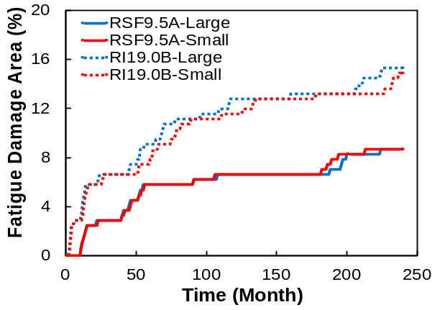
Dynamic Modulus Test
Fatigue Test
Performance Prediction
Paper No. 17-05138 DOI: 10.3141/2631-09
Lectern Session: 1/11/2017 Wed. 08:00am-09:45am (201, Convention Center)
Poster Session: 1/9/2017 Mon. 03:45pm-05:30pm (Hall E, Convention Center)

